Slide 1
Learning Express Library
Cindy Cooley & Atina Jones
Cordova High School

Slide 2
About Learning Express Library
Online practice test center
Includes practice tests, courses, and eBooks
Covers a variety of topics including:
Math and reading skills for Grades 4 & up
College prep tests
Career-based exams
Citizenship exam prep
Popular computer software
Notes:
Test taking can be stressful, and these days test scores mean a lot. Practicing the exam ahead of time, under similar conditions (timed, on a computer) is a good way to prepare.
Learning Express Library is an online practice test center. There are online courses and e-books to help you prepare for and do better on standardized tests. The practice tests are scored instantly and will show you what to work on next. This not only includes high school and college prep exams, but also graduate school, workplace, and citizenship exams. It’s more than just test prep, however. There are also courses on computer programs, like the Microsoft Office suite and Adobe products.
Like any of the other parts of TEL, this is available 24 hours a day, 7 days a week, from any internet connection in Tennessee.

Slide 3
Today you’ll learn how to:
Register for a free account
Take an exam
Download an e-book
Take a tutorial
Notes:
Today you’ll learn how to:
Register for a free account
Take an exam
Download an e-book
Take a tutorial

Slide 4
Start at the CHS Library Site
Mouse over Online Resources and click on Learning Express Library.
Notes:
Show how to access:
Mouse over Online Resources and click on Learning Express Library.

Slide 5
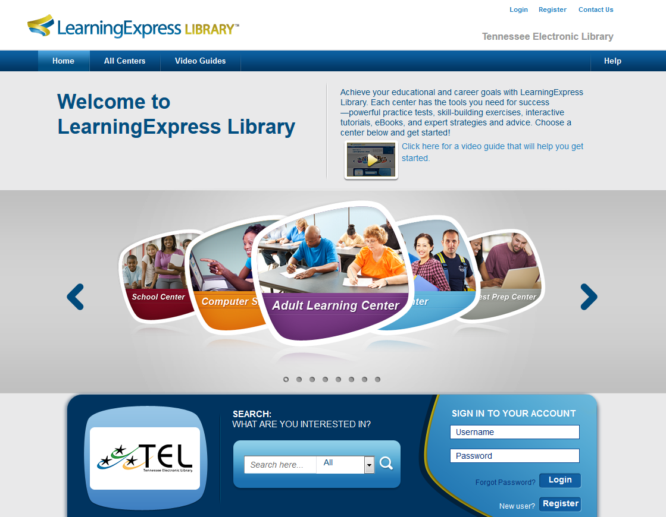
Learning Centers
Notes:
Learning Express Library is divided into 8 different Learning Centers. Use the arrows on the side to scroll thru, or the All Centers dropdown menu.
High School Equivalency Prep Center – practice tests and building test skills for GED and HiSET
College Prep Center – Standardized test prep, AP exam prep, admissions essay prep, etc.
Resources in Spanish – variety of resources in Spanish, including GED test prep and citizenship test prep
College Center – Skills review, placement exam prep, grad school exam prep
School Center – K12 standardized test prep and subject area improvement courses, separated by elementary, middle, and high school levels
Computer Skills – Basic courses on the computer, internet, and OS as well as on software like Microsoft Office Products and Adobe products
Adult Learning Center – Skill improvement courses in math, reading, and writing as well as citizenship exam test prep
Career Center – Job search skills, learn about a career, prep for WorkKeys and TOEIC
Keep your audience in mind when selecting which learning center to focus on. (please feel free to modify this presentation as needed)

Slide 6
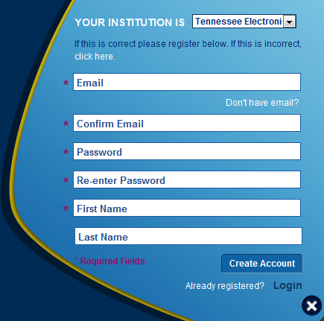
Register for an account
Notes:
The first step to using Learning Express is to create an account. It keeps your account information, like test scores, private. You have to have an account to use any of the to tutorials, tests, or eBooks in Learning Express Library.
Click on Register. (second image is the pop up that will appear when you click Register)
Once you have registered for an account, you will have access to all the resources available in Learning Express Library and your progress as you take tests and courses will be saved. There is an option to register with a username, since not everyone has an email account.
Once you’re registered, click on the Learning Center of your choice. Today we’ll be looking at the GED Test Prep Center.

Slide 7
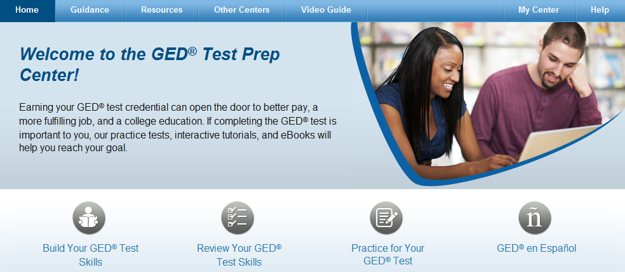
Exam Demonstration
Notes:
Exam 1 Demonstration
Here you’ll see the different options in this Learning Center. Let’s look at our test options.
Click on Practice for Your GED Test.

Slide 8
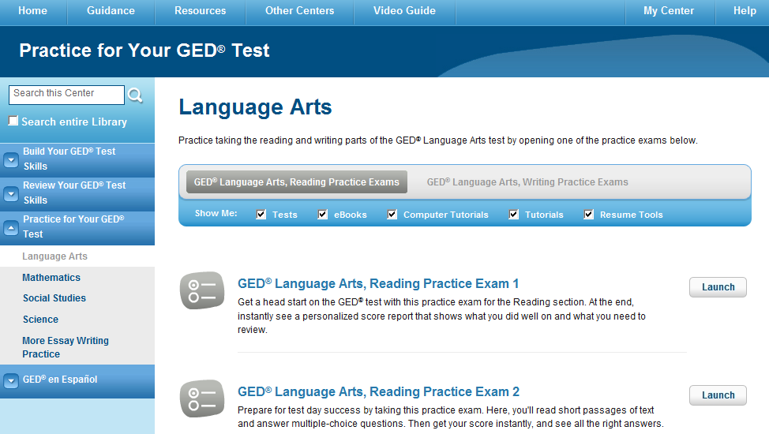
Exam Demonstration
Notes:
The left sidebar shows all of the Learning Center options as well—with the different subjects of practice tests available. Here, Language Arts is the default first option. Click on the other subjects to see those options.
Within the Language Arts subject, there are 2 topics: Reading or Writing. Click there to change topics.
You’ll see the options listed below. You’d click on Launch to start the test, tutorial or e-book. Let’s look at the Reading Practice Exam.

Slide 9
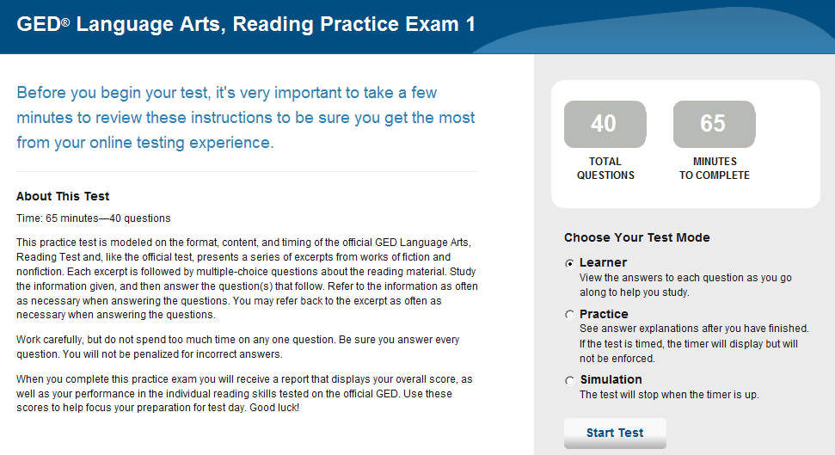
Exam Demonstration
Notes:
Like all tests, there’s an instruction page. You also choose the Test Mode on the right.
Leaner mode you can view the answers to the questions as you go, so it’s more of a study tool. In
practice mode lets you see the answers after you have completed the test. There’s never a time limit in practice mode.
simulation mode is most like taking the real test, so the test will stop when the timer runs out.
Pick your option and click Start Test. For this example, we will take the test in learner mode.

Slide 10
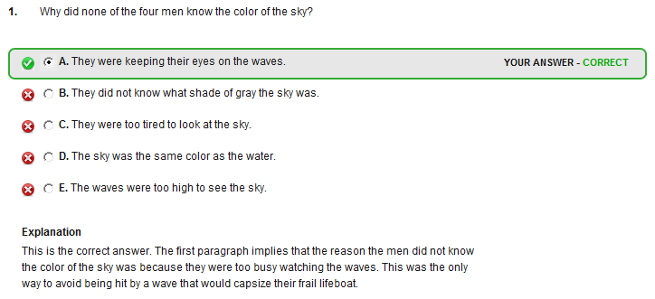
Exam Demonstration
Notes:
In Learner mode, there is a See Answers button. As you complete each page, click this button to see correct answers with a full explanation of why it’s right or wrong.
You can view answers after you’ve completed a test in practice or simulation mode (it’s in the Score Report)
You always have the option, whatever way you take the test, to Save and Finish Later –The test will be paused and your progress saved. The next time you login, you’ll be able to finish it.
Whenever you’re done, click on Score My Test.

Slide 11
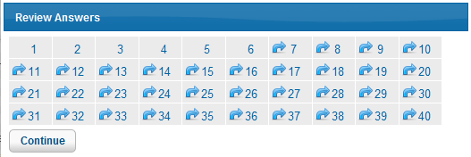
Exam Demonstration
Notes:
Score My Test (shown below) – Clicking this first gives you the option to go back and look at previous answers. Just click on the number of the answer you want to review to be taken back to it. The test will resume if you do this. Questions numbers with an arrow next to them indicate that they are blank, so you can quickly make sure you didn’t skip one by mistake.
If you’re ready to see your score, click on “Continue.” It will warn you that your test will be locked and scored, which is your last chance to turn back. If you’re ready to see the score, click “Continue” again.
It will then bring you to your score report (shown next slide)

Slide 12
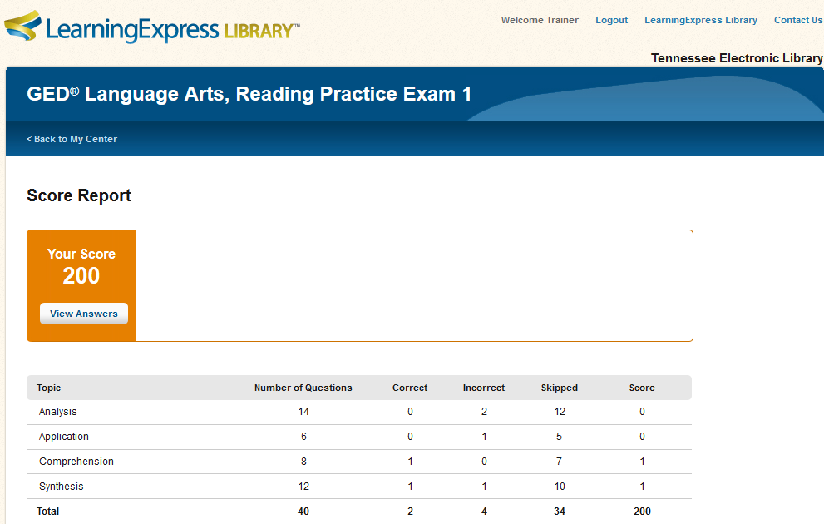
Score Report
Notes:
This will give recommendations about what steps to take next, and which areas need improvement if any.
If there’s another resource that could help, like a tutorial or e-book, it will be listed at the bottom of the page as well.
Let’s take a look at one of the resources for careers in Learning Express—a downloadable e-book.
You can always click on the Learning Express Library logo, or text, at the top of the page to get back to the homepage.

Slide 13
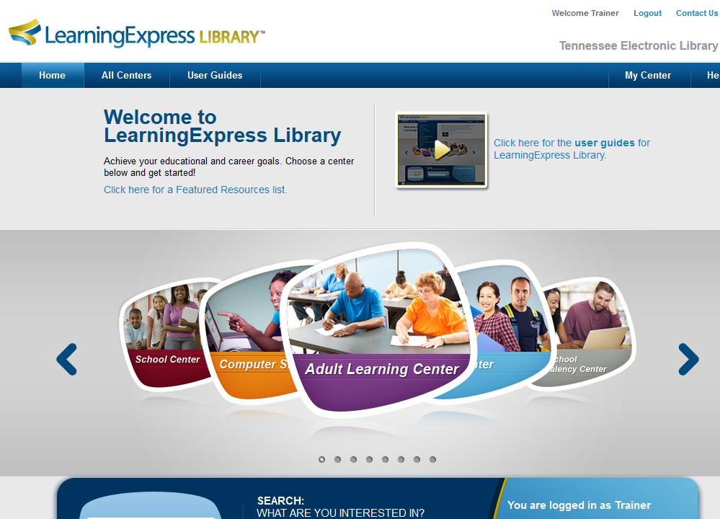
Notes:
Since we’re logged in, there’s a Welcome message at the top, and there’s no longer the option to register for an account. Let’s take a look at the Career Center.

Slide 14
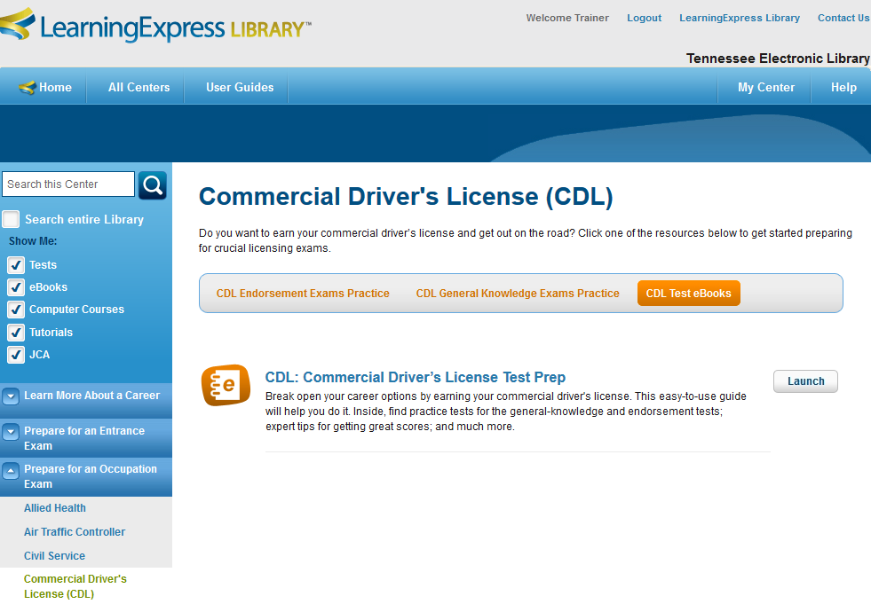
eBooks
Notes:
Here we have the resources for people studying for their Commercial Drivers License. There are practice tests, and tutorials, and an e-book.
Learning Express Library has integrated e-books into the learning centers, so you see them as you go. All of them are in pdf format.
To read the eBook, simply click the “Launch” button and the pdf will appear. You can open it and read on the computer, or save it to the computer, or a flash drive, and read it wherever you go.
And once you Launch this ebook, it will be added to My Center, so you never have to search for it again! Click on My Center to see

Slide 15
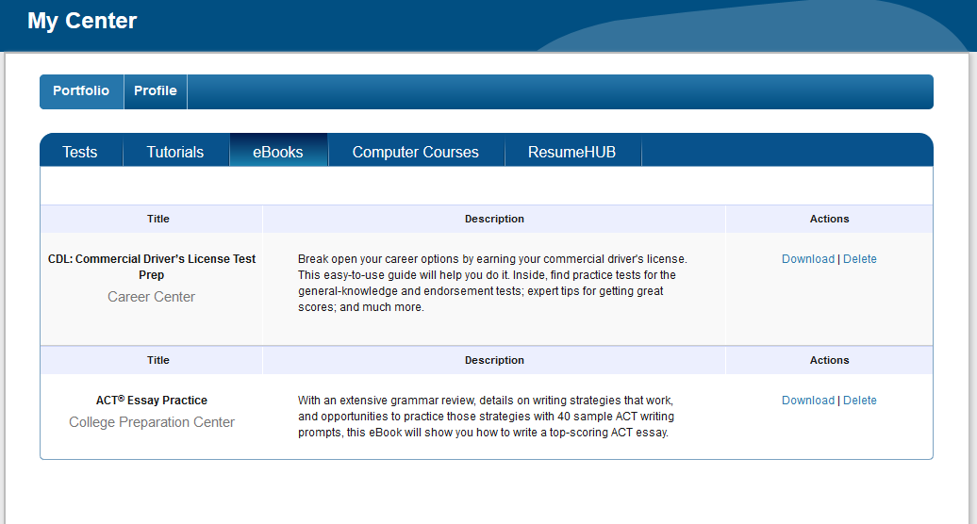
Notes:
My Center tracks your activity in Learning Express Library. Here we see the e-books that have been downloaded before—and there’s no limit to the number of times they can be downloaded.

Slide 16
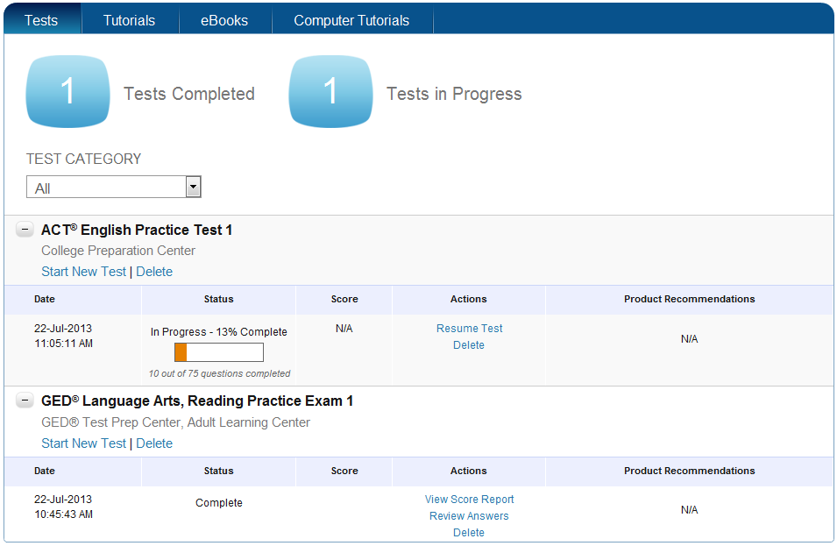
My Center
Notes:
Use the buttons across the top to switch to Tests to see all the options. To review information about the individual tests, click on the + sign next to the test name.
Here, you can see an earlier ACT test that was saved, rather than scored. You can click on “resume test” to continue it.
Since the GED test has been scored, we cannot go back and continue to take it. We can view the score report again or review answers if we want. If the “review answers” option is selected then you can go through the entire test with the correct answers highlighted and the reasoning behind them given. If you want to take this test again, you have to delete it—but that’s why there are multiple versions of each test available.
You can always navigate back to “My Center” by clicking the “My Center” link on the top left of the screen.

Slide 17
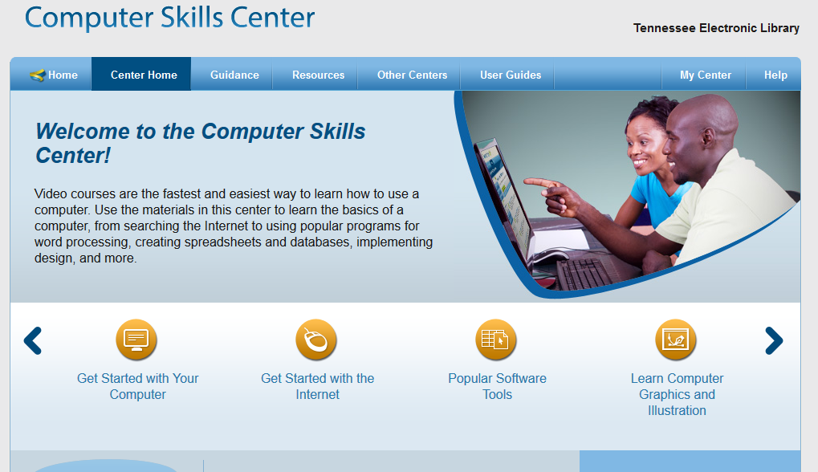
Computer Skills Center
Notes:
The newest part of Learning Express Library is the Computer Skills Center. These are self-paced video tutorials that provide easy to follow, step-by-step directions on a variety of computer tools. Let’s take a look at one of the software programs.

Slide 18
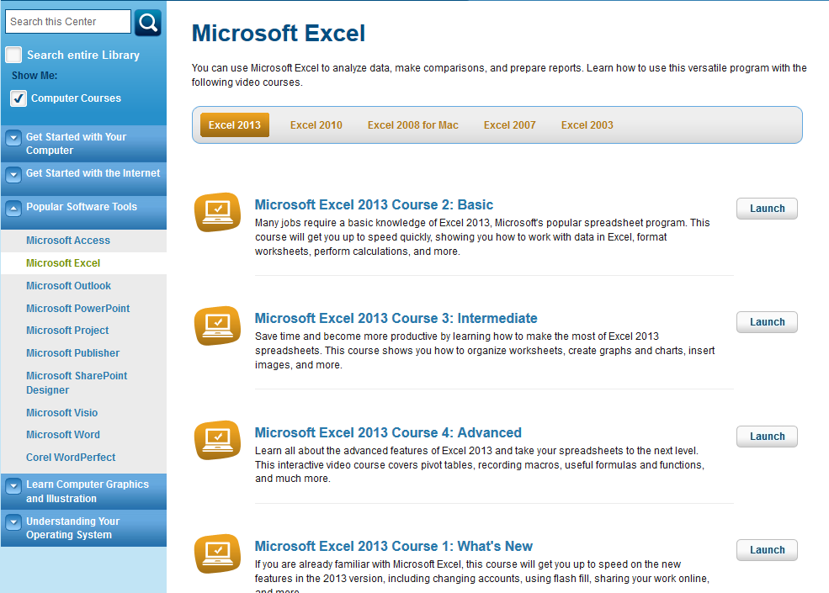
Popular Software Tutorials

Slide 19
Notes:
Videos are organized on the left sidebar. You can skip around if you want, so if there is a video that covers a topic you already know you can skip past it. Videos can be paused, and you can drag the indicator to jump to a different part of the video.
After finishing the course, you’ll get a certificate of completion for the course.
A list of the computer tutorials you have viewed will be saved in the My Center section of the site under Computer Tutorials.

Slide 20
Notes:
I hope you’ve enjoyed this quick overview of Learning Express Library. Be sure to explore the other options!

Slide 21
Questions?
Thank you!
Notes:
Please leave time for questions. You can always check on the answers later and get back to them.

